Slide 1
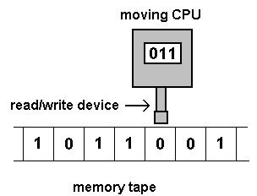
Different Kinds of Automata
Instructor: Hashim Ayub

Slide 2
A widely accepted model of computation
CPU
memory

Slide 3
The different components of memory
temporary memory
input
CPU
output
Program memory

Slide 4
Example:
temporary memory
input
CPU
output
Program memory
compute
compute

Slide 5
temporary memory
input
CPU
output
Program memory
compute
compute

Slide 6
temporary memory
input
CPU
output
Program memory
compute
compute

Slide 7
temporary memory
input
CPU
Program memory
output
compute
compute

Slide 8
Automaton
temporary memory
Automaton
input
CPU
output
Program memory

Slide 9
Automaton
temporary memory
Automaton
input
output
transition
state
CPU+ProgramMem = States + Transitions

Slide 10
Different Kinds of Automata
Automata are distinguished by the type of memory
Finite Automata: no temporary memory
Pushdown Automata: stack
Turing Machines: random access memory

Slide 11
Memory affects computational power:
More flexible memory
results to
The solution of more computational
problems

Slide 12
Finite Automaton
temporary memory
input
Finite Automaton
output
Example: Vending Machines,
Lexical Analyzers
(small computing power)

Slide 13
Pushdown Automaton
Temp.
memory
Stack
Push, Pop
input
Pushdown
Automaton
output
Example: Parsers for Programming Languages
(medium computing power)

Slide 14
Turing Machine
Temp.
memory
Random Access Memory
input
Turing
Machine
output
Examples: Any Algorithm
(highest known computing power)

Slide 15
Power of Automata
Simple
problems
More complex
problems
Hardest
problems
Finite
Automata
Pushdown
Automata
Turing
Machine
Less power
More power
Solve more
computational problems

Slide 16
Turing Machine is the most powerful
known computational model
Question: can Turing Machines solve
all computational problems?
Answer: NO
(there are unsolvable problems)
Notes:
What is Turing Test?

Slide 17
Any Questions
Thanks

